Slide 1


EFFECTIVE HEART DISEASE PREDICTION USING FEATURE SELECTION
Name : S.Pavithra
Reg no: 21MCA0182
Guide : Chemmalar Selvi G

Slide 2
INTRODUCTION
Cardiovascular diseases have become a significant concern after the Covid-19 pandemic, affecting people of all ages.
The World Health Organization (WHO) estimates that 17.9 million people worldwide die each year as a result of heart-related disorders.
It is also found that by 2030, 40.5% of the US population is projected to have some form of CVD.
The major challenge faced today in the world by medical sciences are Quality service, Accurate prediction, and Precise results.
Thus it is essential to develop innovative approaches to monitor and address the potential long-term cardiovascular consequences and ensure the best possible outcomes for those affected
With the help of necessary steps, various techniques and machine learning (ML), we can find a solution for reducing and understanding symptoms associated with heart disease.

Slide 3
Literature Survey
Muhammad Salman et al [1] analyzed the effect of selecting required features on the Cleveland and Framingham dataset and compared the results with many machine learning classifiers. With the ANOVA-F test- to select important features, the accuracy was increased to 75% and 71% for both datasets, respectively.
Senthilkumar Mohan et al [2] introduced a new effective cardiac disease prediction approach with the help of hybrid random forest with a linear model (HRFLM) on UCI Cleveland dataset and achieved the highest accuracy of 88.4%.
C. Pan et al [3] did an evaluation on the effects of numerical, categorical and combination of both types of features on ensemble machine learning frameworks. A soft voting ensemble approach was also presented, and comparisons were made between the boosting algorithms and other deep learning and machine learning algorithms. The categorical features performed well compared to the numerical and combined features, according to 10 distinct performance criteria. Furthermore, it was shown that the ensemble learning of SVM + AdaBoost classifiers with categorical features gave the best CVD prediction performance, with an SVM with categorical features score of 92.97 and a random forest technique score of 74.23

Slide 4
LIMITATION OF EXISTING SYSTEM
Lack of implementation on selecting the required input features for the development of prediction models which is an important aspect in terms of heart disease predictive performance.
Thus this study aims in using more feature selection techniques on different machine learning to compare and obtain more feasible feature subsets.
Improving the accuracy and overall performance of the model is also a major concern.

Slide 5
Objectives
Data pre-processing to remove all irrelevant, unexplained, outliers or null values that may affect the prediction results.
To use more feature selection techniques and find the important risk factors in the dataset.
Balancing the highly imbalanced dataset using SMOTE (Synthetic Minority Over-sampling Technique) technique
To enhance the prediction accuracy by using various machine learning and deep learning models.
Comparative study of tested classification models on full as well as the reduced feature subset.
Propose a hybrid model which takes advantage of data balancing, feature map using CNN and stacking classifier. (SMOTE+ Feature map using CNN+ Stacking)
Performance evaluation using accuracy, balanced accuracy, precision, ROC AUC, and F1 score.

Slide 6
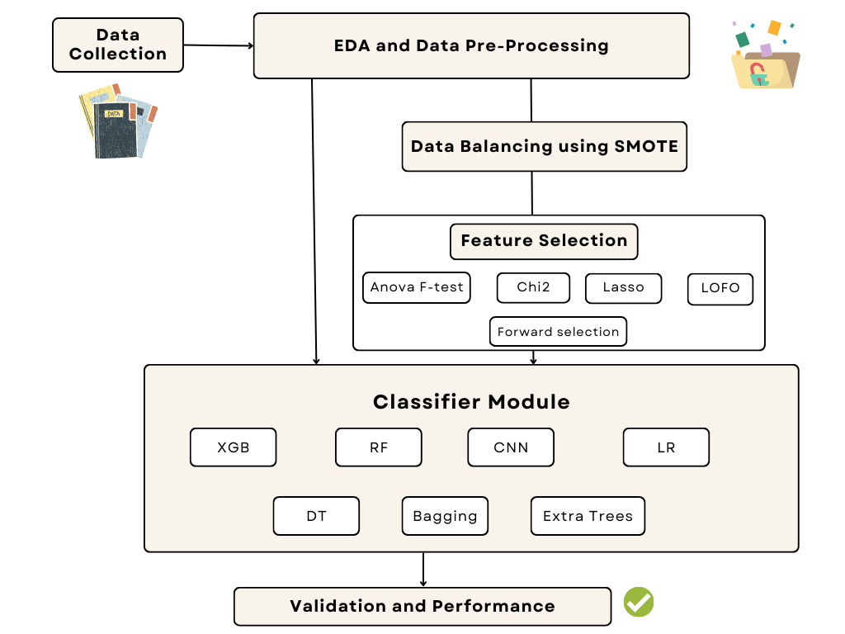
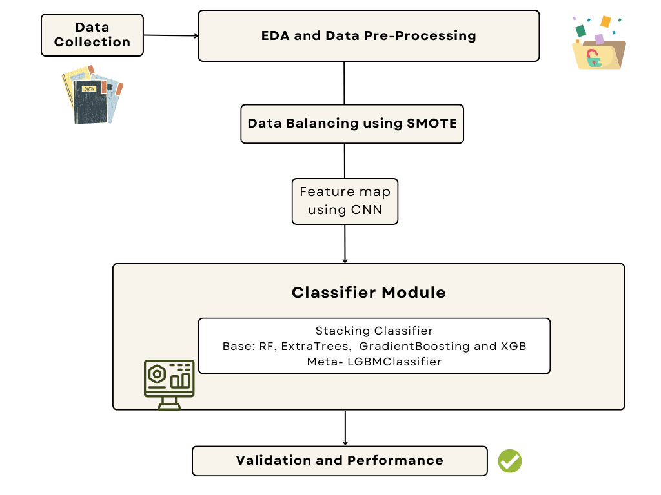
Proposed Methodology & Architecture
Fig. 1. Methodology 1
Fig. 2. Methodology 2 (Proposed hybrid model)

Slide 7
Proposed methodology 1
Data Collection
Framingham dataset is collected from Kaggle.
It is a numerical dataset having 16 features including the target ‘TenYearCHD’ and 4238 records in total.
Data Pre-Processing and EDA process
Data pre-processing:- eliminating any duplicates, regularities in the data, scaling and removing outliers (capping/ trimming)
Summarizing the data using descriptive statistics: provides an overview of the data and can help identify potential issues or trends
Exploratory Data Analysis (EDA): understanding the data , identify patterns, trends, and relationships in the data
Visualizing the data using different types of plots such as histograms, scatter plots, box plots, and heat map

Slide 8
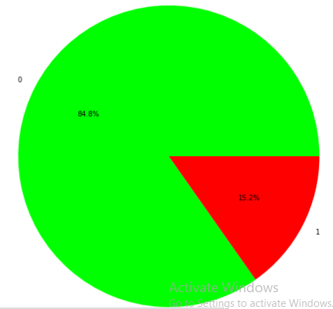
Feature selection
Feature selection methods- select only the most critical variables and eliminates the redundant and irrelevant ones.
Benefits of performing feature selection: reduces over fitting, improves performance, reduces training time
Types- Filter, wrapper and embedded methods
In this paper, Anova F-test, Chi-squared, Forward selection, LASSO and LOFO feature selection techniques are used.
Data Balancing
Framingham data is highly imbalanced (85:15): result in biased models
Data balancing: process of adjusting the distribution of data in a dataset to ensure that the number of instances in each class is approximately equal.
Data balancing techniques- Oversampling and Undersampling
SMOTE (Synthetic Minority Over-sampling Technique) is a popular oversampling technique and it improve the sensitivity of the model while maintaining a high level of specificity (i.e., the ability to correctly identify negative cases of heart disease).

Slide 9
It works by generating synthetic examples of the minority class by interpolating between existing examples.
It selects a minority class example and creates new synthetic examples by taking linear combinations of its feature values with those of its nearest minority class neighbors.
Splitting into Training and Testing
To evaluate the performance of a machine learning model on unseen data: 80-20 ratio of training vs testing.
Classifier Module
Different ML classifiers like Naïve Bayes, k Nearest, Neighbor (KNN), Decision tree, SVM, Random Forest, and deep learning algorithms like convolutional neural networks are used to compare and find the most classification algorithm which accurately classifies the heart disease patients.
Validation and Performance
Model validation- the process where a trained model is evaluated with testing data set to ensure the accuracy of our proposed model (as it helps us to see how our model reacts to unseen data.)
Performance metrics are used to measure the behaviour, activities, and the performance of the models- Accuracy, precision, recall, F1-score and confusion matrix.

Slide 10
 | Without Feature Selection and Smote | With Feature Selection and Smote
 |  | Anova F-test | Chi-squared test | Forward selection | Lasso | LOFO
RandomForestClassifier | 0.84 | 0.86 | 0.87 | 0.90 | 0.87 | 0.91
ExtraTreesClassifier | 0.83 | 0.84 | 0.85 | 0.91 | 0.88 | 0.92
XGBClassifier | 0.82 | 0.89 | 0.86 | 0.88 | 0.90 | 0.90
BaggingClassifier | 0.82 | 0.83 | 0.85 | 0.87 | 0.83 | 0.88
LogisticRegression | 0.84 | 0.68 | 0.65 | 0.68 | 0.68 | 0.66
LGBMClassifier | 0.82 | 0.89 | 0.86 | 0.88 | 0.89 | 0.89
DecisionTreeClassifier | 0.75 | 0.76 | 0.81 | 0.82 | 0.80 | 0.83
AdaBoostClassifier | 0.83 | 0.67 | 0.78 | 0.80 | 0.72 | 0.81
SGDClassifier | 0.83 | 0.61 | 0.64 | 0.66 | 0.67 | 0.64
Perceptron | 0.82 | 0.55 | 0.55 | 0.60 | 0.56 | 0.60
SVC | 0.83 | 0.67 | 0.69 | 0.71 | 0.71 | 0.72
BernoulliNB | 0.80 | 0.61 | 0.64 | 0.64 | 0.63 | 0.62
NearestCentroid | 0.67 | 0.62 | 0.64 | 0.64 | 0.67 | 0.62
CalibratedClassifierCV | 0.83 | 0.67 | 0.65 | 0.68 | 0.68 | 0.66
RidgeClassifierCV | 0.84 | 0.67 | 0.65 | 0.68 | 0.68 | 0.66
KNeighborsClassifier | 0.83 | 0.78 | 0.73 | 0.76 | 0.81 | 0.77
LabelSpreading | 0.79 | 0.79 | 0.78 | 0.84 | 0.85 | 0.83
LabelPropagation | 0.78 | 0.80 | 0.78 | 0.85 | 0.85 | 0.83
GaussianNB | 0.80 | 0.62 | 0.64 | 0.63 | 0.62 | 0.60
RidgeClassifier | 0.84 | 0.67 | 0.65 | 0.68 | 0.68 | 0.66
ExtraTreeClassifier | 0.76 | 0.77 | 0.79 | 0.78 | 0.79 | 0.77
LinearDiscriminantAnalysis | 0.84 | 0.67 | 0.65 | 0.68 | 0.68 | 0.66
PassiveAggressiveClassifier | 0.82 | 0.57 | 0.61 | 0.65 | 0.51 | 0.59
LinearSVC | 0.84 | 0.67 | 0.65 | 0.67 | 0.68 | 0.66
QuadraticDiscriminantAnalysis | 0.80 | 0.61 | 0.65 | 0.65 | 0.59 | 0.61
DummyClassifier | 0.83 | 0.50 | 0.50 | 0.50 | 0.50 | 0.50
RESULTS

Slide 11
Before Feature Selection
Classifiers | Accuracy | Precision | Recall | F1 Score | Confusion matrix
Extra Trees Classifier | 0.830 | 0.444 | 0.065 | 0.114 | [[600 10] [114 8]]
Bagging Classifier | 0.831 | 0.428 | 0.024 | 0.046 | [[606 4] [119 3]]
CNN | 0.827 | 0.36 | 0.04 | 0.07 | [[601 9] [117 5]]
Logistic Regression | 0.838 | 0.666 | 0.065 | 0.119 | [[606 4] [114 8]]
Decision Tree | 0.766 | 0.297 | 0.295 | 0.296 | [[525 85] [ 86 36]]
Gradient Boosting | 0.840 | 0.619 | 0.106 | 0.181 | [[602 8] [109 13]]
XGBOOST | 0.812 | 0.325 | 0.114 | 0.169 | [[581 29] [108 14]]
Random Forest | 0.837 | 0.588 | 0.081 | 0.143 | [[603 7] [112 10]]
After Anova Feature Selection
Classifiers | Anova F-test
 | Accuracy | Precision | Recall | F1 Score | Confusion matrix
Extra Trees Classifier | 0.842 | 0.850 | 0.832 | 0.841 | [[529 91] [104 516]]
Bagging Classifier | 0.687 | 0.675 | 0.720 | 0.697 | [[405 215] [173 447]]
CNN | 0.617 | 0.67 | 0.55 | 0.60 | [[406 181] [293 360]]
Logistic Regression | 0.677 | 0.688 | 0.648 | 0.667 | [[438 182] [218 402]]
Decision Tree | 0.794 | 0.784 | 0.811 | 0.797 | [[482 138] [117 503]]
Gradient Boosting | 0.756 | 0.759 | 0.75 | 0.754 | [[473 147] [155 465]]
XGBOOST | 0.890 | 0.908 | 0.867 | 0.887 | [[566 54] [ 82 538]]
Random Forest | 0.862 | 0.869 | 0.851 | 0.860 | [[541 79] [ 92 528]]

Slide 12
After chi-square Feature Selection
Classifiers | Chi2
 | Accuracy | Precision | Recall | F1 Score | Confusion matrix
Extra Trees Classifier | 0.846 | 0.853 | 0.839 | 0.846 | [[526 90] [100 524]]
Bagging Classifier | 0.743 | 0.744 | 0.746 | 0.745 | [[456 160] [158 466]]
CNN | 0.675 | 0.67 | 0.70 | 0.69 | [[398 218] [185 439]]
Logistic Regression | 0.652 | 0.653 | 0.658 | 0.656 | [[398 218] [213 411]]
Decision Tree | 0.808 | 0.801 | 0.823 | 0.812 | [[489 127] [110 514]]
Gradient Boosting | 0.818 | 0.896 | 0.722 | 0.800 | [[564 52] [173 451]]
XGBOOST | 0.867 | 0.892 | 0.838 | 0.864 | [[553 63] [101 523]]
Random Forest | 0.868 | 0.892 | 0.839 | 0.865 | [[553 63] [100 524]]
After Forward Selection
Classifiers | Forward Selection
 | Accuracy | Precision | Recall | F1 Score | Confusion matrix
Extra Trees Classifier | 0.914 | 0.923 | 0.905 | 0.914 | [[569 47] [ 59 565]]
Bagging Classifier | 0.728 | 0.714 | 0.766 | 0.739 | [[425 191] [146 478]]
CNN | 0.706 | 0.69 | 0.73 | 0.71 | [[411 205] [166 458]]
Logistic Regression | 0.676 | 0.677 | 0.682 | 0.679 | [[413 203] [198 426]]
Decision Tree | 0.827 | 0.833 | 0.820 | 0.827 | [[514 102] [112 512]]
Gradient Boosting | 0.840 | 0.888 | 0.780 | 0.831 | [[555 61] [137 487]]
XGBOOST | 0.889 | 0.920 | 0.854 | 0.886 | [[570 46] [ 91 533]]
Random Forest | 0.895 | 0.922 | 0.863 | 0.892 | [[571 45] [ 85 539]]

Slide 13
After LASSO (Least Absolute Shrinkage & Selection Operator)
Classifiers | LASSO
 | Accuracy | Precision | Recall | F1 Score | Confusion matrix
Extra Trees Classifier | 0.883 | 0.866 | 0.907 | 0.886 | [[529 87] [ 58 566]]
Bagging Classifier | 0.704 | 0.676 | 0.793 | 0.730 | [[379 237] [129 495]]
CNN | 0.688 | 0.68 | 0.71 | 0.70 | [[409 207] [179 445]]
Logistic Regression | 0.678 | 0.679 | 0.682 | 0.681 | [[415 201] [198 426]]
Decision Tree | 0.789 | 0.791 | 0.790 | 0.790 | [[486 130] [131 493]]
Gradient Boosting | 0.773 | 0.768 | 0.786 | 0.777 | [[468 148] [133 491]]
XGBOOST | 0.888 | 0.909 | 0.865 | 0.886 | [[562 54] [ 84 540]]
Random Forest | 0.865 | 0.862 | 0.871 | 0.866 | [[529 87] [ 80 544]]
After LOFO(Leave One Feature Out)
Classifiers | LOFO
 | Accuracy | Precision | Recall | F1 Score | Confusion matrix
Extra Trees Classifier | 0.922 | 0.917 | 0.929 | 0.923 | [[564 52] [ 44 580]]
Bagging Classifier | 0.761 | 0.723 | 0.850 | 0.782 | [[413 203] [ 93 531]]
CNN | 0.690 | 0.67 | 0.75 | 0.71 | [[387 229] [159 465]]
Logistic Regression | 0.656 | 0.666 | 0.634 | 0.650 | [[418 198] [228 396]]
Decision Tree | 0.833 | 0.827 | 0.844 | 0.835 | [[506 110] [ 97 527]]
Gradient Boosting | 0.837 | 0.890 | 0.772 | 0.827 | [[557 59] [142 482]]
XGBOOST | 0.896 | 0.924 | 0.865 | 0.894 | [[572 44] [ 84 540]]
Random Forest | 0.908 | 0.918 | 0.897 | 0.907 | [[566 50] [ 64 560]]

Slide 14
Proposed hybrid methodology 2
The proposed hybrid approach is first oversampled using SMOTE to balance the class distribution.
A convolutional neural network (CNN) is defined and trained on the original dataset to extract features.
The extracted features are concatenated with the original dataset to create a new feature matrix.
The base classifiers (RandomForestClassifier, ExtraTreesClassifier, GradientBoostingClassifier and XGBoostClassifier) are trained on the new feature matrix.
The predictions from the base classifiers are concatenated to create a new feature matrix, and a LightGBM Classifier is trained on this matrix to create the final stacked model.
The Framingham dataset contains a large number of features and records- makes traditional feature extraction methods time-consuming and computationally expensive.
CNNs can efficiently process large amounts of data in parallel, making them well-suited for datasets with many variables. Dataset also contains many variables that are likely to interact in complex, nonlinear ways to influence the risk of heart disease.

Slide 15
The purpose of using a CNN in this proposed hybrid model is to learn and extract high-level features that may not be easily captured by traditional machine learning algorithms.
By combining these as base classifiers in a stacked model, we can take advantage of the strengths of each algorithm.
The stacked model can learn to combine the predictions of the base classifiers to achieve better performance than any individual classifier.
In this way, the proposed model using features identified by CNN and stacked classifier ultimately increased the overall accuracy and robustness of the model on the Framingham dataset.
The performance of the different classifiers and proposed model is evaluated using several metrics including accuracy.
Classification report is also generated which includes the precision, recall, and F1 score for each class (0 and 1), and the balanced accuracy score, which takes into account the imbalance of the classes.

Slide 16
Performance Metrics on Proposed Hybrid Model
PROPOSED HYBRID MODEL | Accuracy | Precision | Recall | F1 Score | Confusion matrix | ROC-AUC score
CNN feature map+ smote+ stacking classifier | 94.44% | 92.89% | 96.31% | 94.57% | [[570 46] [ 23 601]] | 94.42%

Slide 17
CODE SNIPPET
cnn = models.Sequential([
layers.Reshape((X_train.shape[1], 1, 1), input_shape=(X_train.shape[1], 1, 1)),
layers.Conv2D(32, (3, 1), activation='relu', padding='same'), # extract features
layers.MaxPooling2D((2, 1)), #Max Pooling retains the most prominent features
layers.Conv2D(64, (3, 1), activation='relu', padding='same'),
layers.MaxPooling2D((2, 1)),
layers.Conv2D(128, (3, 1), activation='relu', padding='same'),
layers.MaxPooling2D((2, 1)),
layers.Flatten(),
layers.Dense(128, activation='relu'),
layers.Dense(64, activation='relu'),
layers.Dense(32, activation='relu')])
cnn.compile(optimizer='adam', loss='binary_crossentropy')
cnn.fit(X_train, y_train, epochs=10, validation_split=0.2)
X_cnn = cnn.predict(X.values.reshape(X.shape[0], X.shape[1], 1, 1))
X_combined = np.concatenate((X, X_cnn), axis=1) #combine the features with original dataset
smote = SMOTE()
X_combined_resampled, y_resampled = smote.fit_resample(X_combined, y)

Slide 18
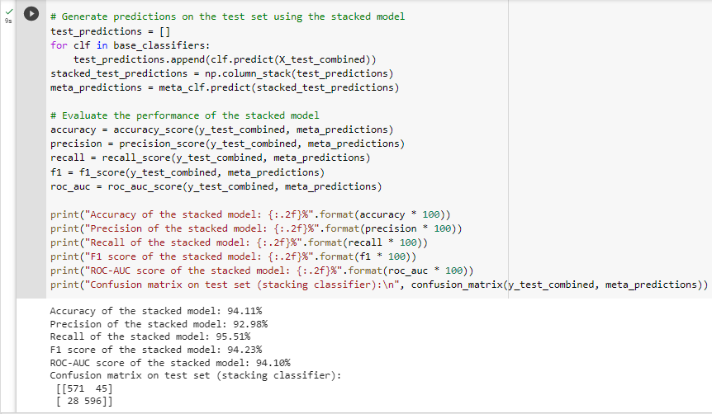

Slide 19
Conclusion
The work started with exploratory data analytics, observing each attributes and their relations, visualizing the data using heat map
Training of machine learning models with all features and with only selected features were then carried out and compared.
On implementing the Leave One Feature Out (LOFO) importance technique(claimed age, male, sysBP, heartRate, prevalentHyp, education, cigsPerday, diaBP, diabetes as top 9 features), we observed significant change in the performance metrics.
Least Absolute Shrinkage and Selection Operator(LASSO) Feature Importance technique stated that totchol, glucose, cigsPerDay, age, sysBP are the most 5 important features of our dataset. Using this, we were able to half the number of features in the model without changing the accuracy.

Slide 20
Anova F-test, which used only 4 features and LOFO on the other hand with 9 features gave us good results overall.
After implementing the 5 techniques, it is found that all of them gave us high accuracy with similar or less set of important features.
Data balancing using SMOTE also had a huge impact on the performance of the model.
The proposed hybrid approach used data balancing, features extracted using CNN, and finally a stacking classifier to get more accurate results with the accuracy of 94.44%, precision of 92.89%, Recall of 96.31%, F1 score of 94.57% without any overfitting.

Slide 21
Future Works
In the future, this work can further be enhanced to the prediction by using a vast combination of ML and deep learning models to obtain the best feasible model for the heart disease diagnosis.
Furthermore, a new feature selection method can be developed to get a broader perception of the significant features
We can also benchmark our analysis on additional datasets.

Slide 22
THANK YOU!

